Slide 1
WebVR

Slide 2
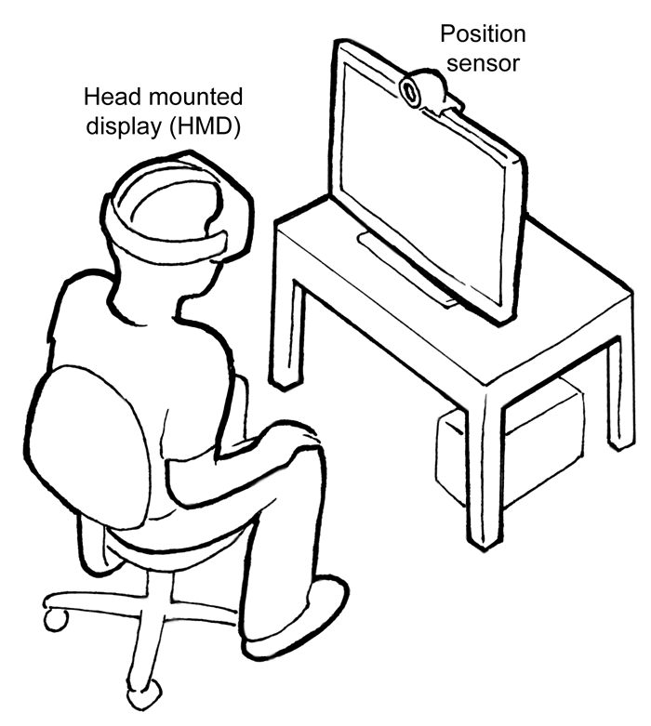
What is WebVR?
API that enables the browser to work/interact with VR headsets
🎧👍 / 🕹 🚫
Navigator.getVRDisplays(),
VRDisplay.isConnected(), rAF, frame, pose, stage, etc...
Notes:
The API has nothing to do with VR controllers, those are enabled via the Gamepad API

Slide 3
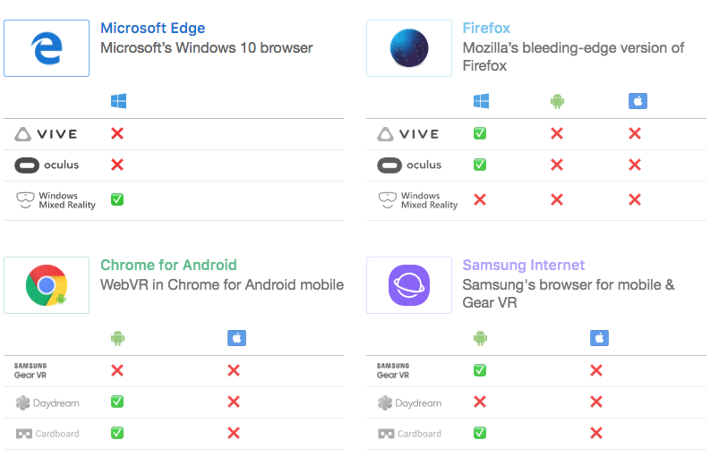
Notes:
Browser support is shit. Specially iOS.
Even Playstation browser doesn’t support the API, even though they have VR.

Slide 4
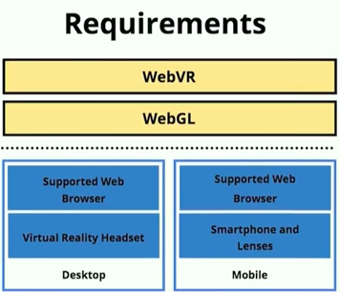
WebVR Requirements
Notes:
- WebGL, a graphic library API , enables browser to render interactive 2d and 3d graphics - canvas element, enables drawing of graphics and animations via scripting

Slide 5
WebVR Development

Slide 6

A-Frame
Three.js Framework
Beginner friendly
Declarative way of writing code (Entity-Component Architecture)
Polyfils your browser
Inspector (GUI)
Code / Hello World
Notes:
Show code and hello world (and inspector)
Serve inside vrthechampions

Slide 7
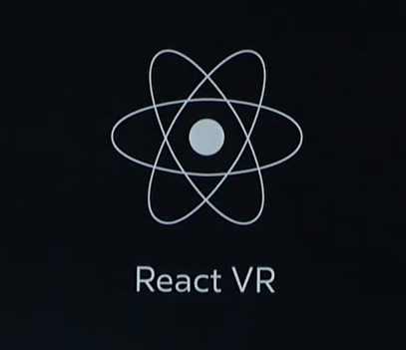

ReactVR
ReactNative modules (Bloated)
Also build using Three.js
In its infancy, Aframe is miles ahead.
Lack of features like camera movement. (Possible but complex)
Code / Hello World
Notes:
Lack of features like camera movement. It’s possible but complex (as opposed to AFrame).
Buggy startup because node.
Bloated (react vr > react native > core react)
Due to React popularity, it has chances to succeed.
Npm start inside react folder

Slide 8


Other tools:
Notes:
Unity: game development tool, not for the web but there are some hacky ways of getting it to un in webGL
Three.js: if you want to go full javascript

Slide 9
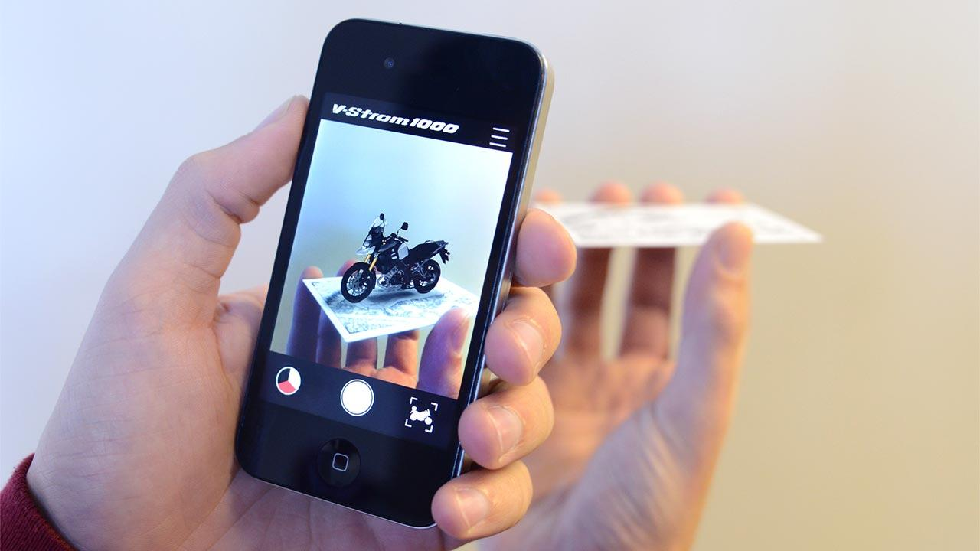
WebAR
Augmented Reality
Similar technologies (Stereoscopic Rendering, Positional Tracking, WebGL, etc.)
WebXR (VR+AR)
Development = AR.js - AR plugin for A-Frame - based on markers (barcode, QR code, or any image) - Current iOS does not support WebRTC 😭 (iOS11 😃)
Code / Hello World

Slide 10
Thanks!
Code at: github.com/jpedroribeiro/VRTheChampions

